Slide 1
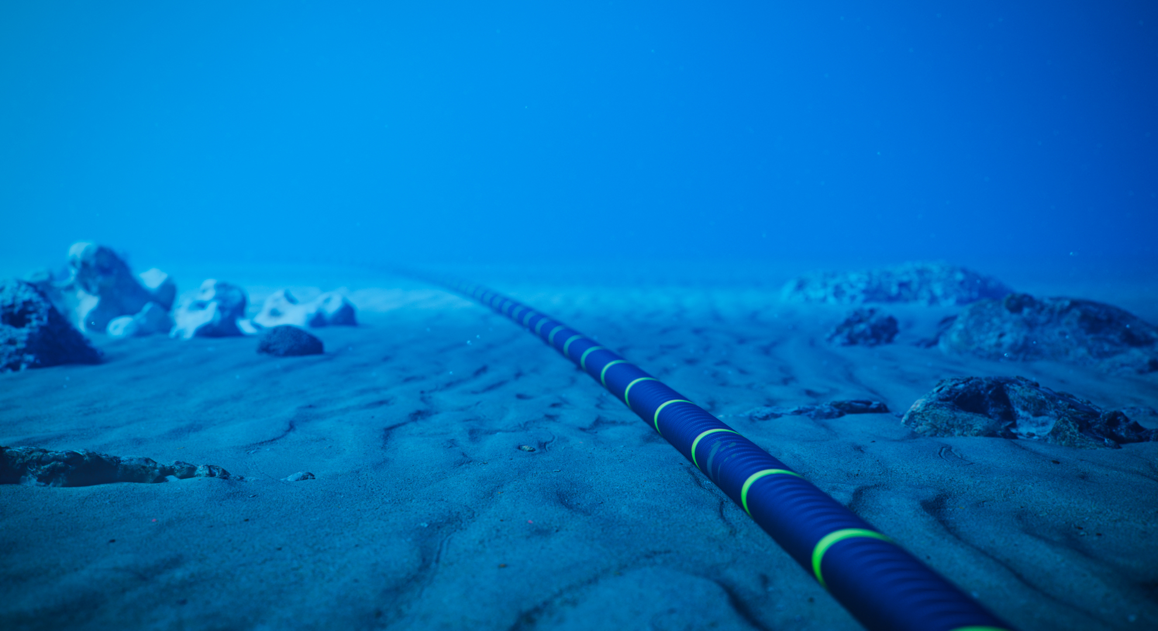

Iraq Roles in Global Transit and Submarine Cable Networks
By: Dr Kassim Al-Hassani
30th August 2025

Slide 2
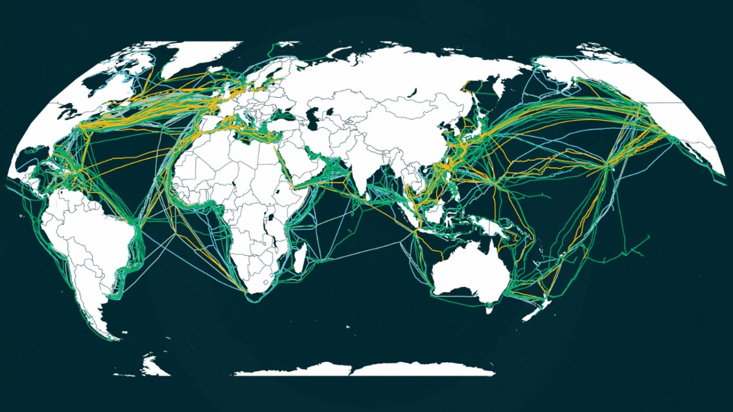
Global Submarine Cable Systems
(as of early 2025)
In-service systems: 570 submarine cable systems are currently operational worldwide.
Under construction or planned: 81 additional systems are either being built or planned.
Total submarine cable length: Over 1.48 million km of submarine cables are in service.
Coverage of international traffic: These cables carry approximately 99% of global data traffic
These cables carry data for internet, telephone, and private data traffic across continents, enabling instant communication and connectivity worldwide.
Modern submarine cables are capable of carrying terabits of data per second, offering high-speed internet and reducing latency.

Slide 3
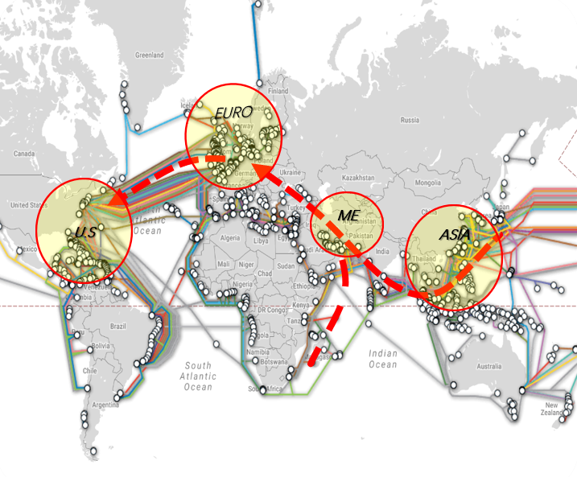
EMEA Region is the Key Location between Europe and Asia
Traffic Carried by Submarine System
Submarine System:
  Current System: Over 200
  Current Capacity: exceeds 400 Tbps
  15–20 systems Planned Additional Capacity: 400–500 Tbps+
Huge Potential for Future Capacity:
Up to end of Y2025, Cross EMEA Region
  Europe ~ Middle East 80-90 Tbps.
  Africa ~ Middle East 10–12 Tbps
  Asia ~ Europe (100–120 Tbps)
  Asia ~ Middle East (20–25 Tbps)
2027 after lit of 4 submarine cables and if we Consider 10%-20. Total Africa/ME/Asia traffic go through Iraq to Europe. 30–35 Tbps.

Slide 4
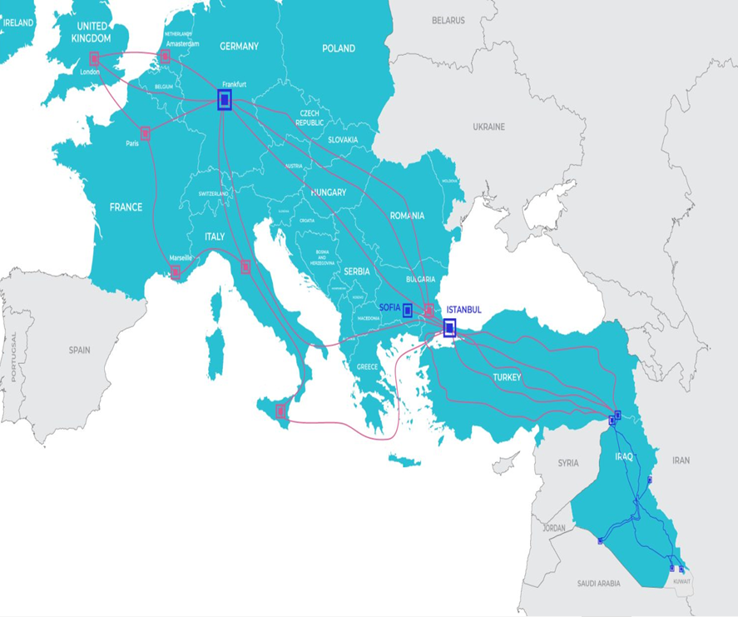
Strategic Location
Internet traffic: The Middle East is a crucial transit region for global internet traffic, linking Europe, Asia, and Africa.
Iraq's geographic location is strategically important for submarine cable routes connecting these regions.
Attracting Investment: Enhanced connectivity draws attracts global tech companies, data centres, and IT services, driving economic growth and fostering digital innovation.
Supporting National and Regional Development: Enhanced internet infrastructure boosts e-government, e-commerce, and digital education initiatives, contributing to Iraq's socio-economic development.

Slide 5
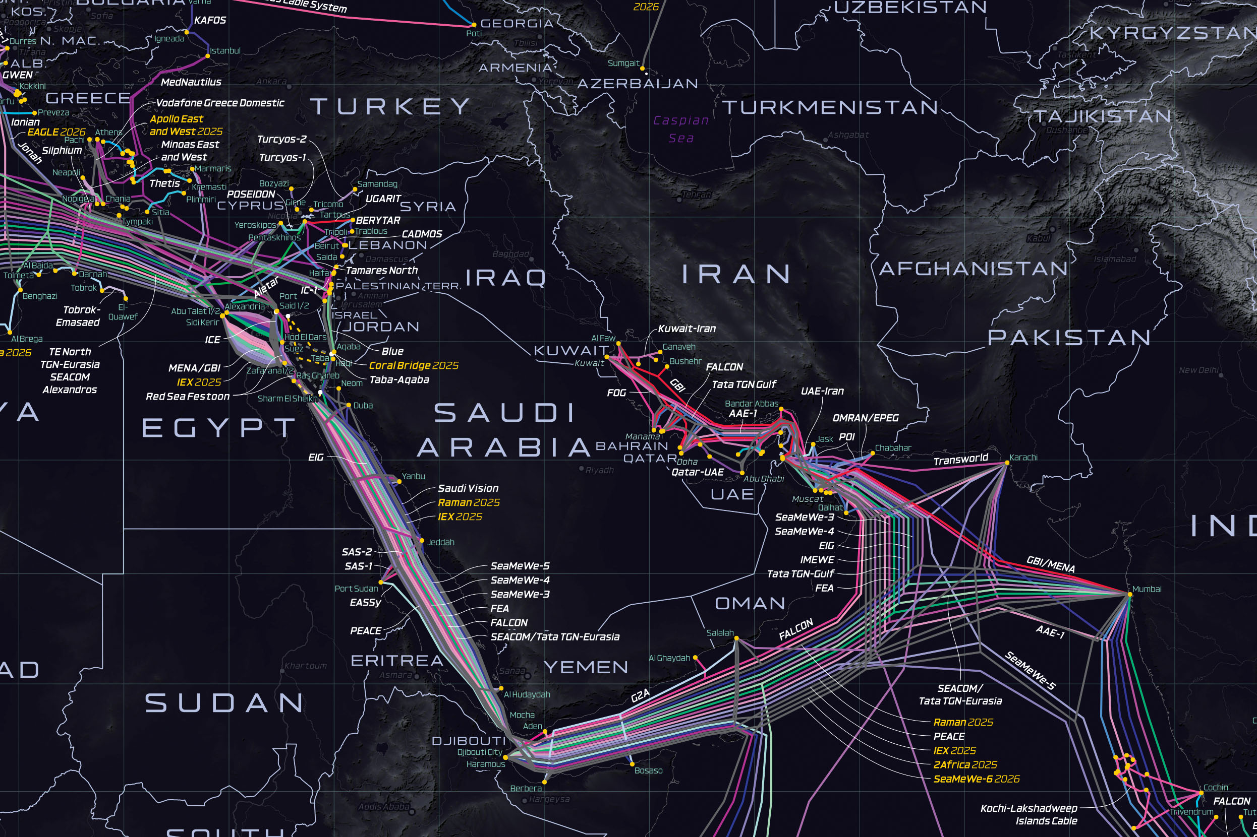
M.E. Submarine cable Systems
The Middle East serves as a vital transit hub for global internet traffic, with dense submarine cable landings linking Europe, Asia and Africa .
Iraq’s geographic location places it at the heart of the Middle East, making it a natural transit point for submarine cables connecting Europe, Asia, and Africa. Its land-based routes offer a strategic alternative to traditional marine paths, enabling faster, more secure, and diversified global data traffic
Egypt is a bottleneck for the world’s internet. If something goes wrong there, half the world’s traffic slows down.
Iraq sits right in the middle of Asia, Europe, and the GCC and is opening its borders, building infrastructure, and inviting investment.
The GCC sees Iraq as the “new bridge” to Europe—faster, safer, and better for future growth.

Slide 6
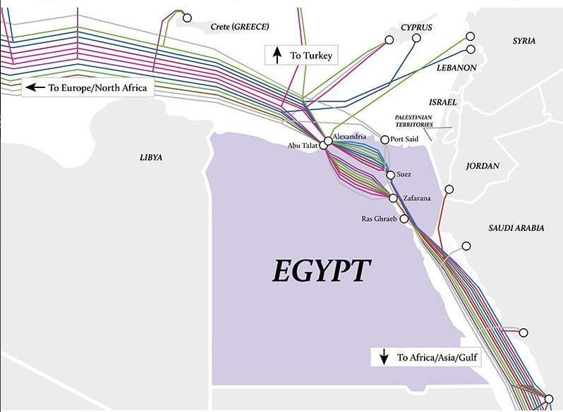
Egypt fiber optic cable crossing
Egypt is like a single busy bridge for the world’s internet traffic. If anything happens on that bridge—an accident, congestion, or damage—the whole region’s internet slows down or stops.
Global Submarine Chokepoint | Heavy reliance on a few cables landing in Alexandria, which are vulnerable to damage or disruption.
Monopolized Infrastructure | Telecom Egypt’s control over infrastructure restricts competition and slashes upgrade pace.
Aging, Centralized Assets | Key hubs like the Ramses building are outdated and represent single points of failure.
Poor Service Experience | Speeds don’t meet expectations; deployment is uneven; congestion is common.

Slide 7
Terrestrial Transit
Ibrahim Al-Khalel (Turkey)
Rabia'a-Musel (Turkey)
Terrestrial Transit into Iraq from Neighbouring Countries
1. Turkey → Iraq
Ibrahim Khalil Border Crossing: This is a major gateway between Turkey and northern Iraq (KRG).
Development Road Initiative: A large-scale multimodal corridor (railways, highways) planned to link Faw (in Basra) with Turkey. It’s expected to span 1,200 km, cost around $17 billion, and includes the Grand Faw Port.
2. Iran → Iraq
3. Jordan → Iraq Karameh/Turail
4. Kuwait → Iraq
5. Saudi Arabia → Iraq Arar Border.
6. Syria → Iraq
Al-Qa'im / Abu Kamal Crossing: Recently reopened (June 14, 2025)
Duhok
Erbil
Mosul
Haj Omran (Iran)
Altun Kubri (KRG
Sulaimaniyah
Kirkuk
Tikrit
Bashmakh (Iran)
Anbar
Diyala
Trabeel (Jordan)
Operational in
mid-2019
Montheria (Iran)
Baghdad
Kut
Hilla
Badra (Iran)
Karbala
Ammara
Najaf
Diwanyiah
Nasiryah
Samawa
Basra
Sawfan (Kuwait)
Shalamcha (Iran)
Umm Qasr (Kuwait) :

Slide 8
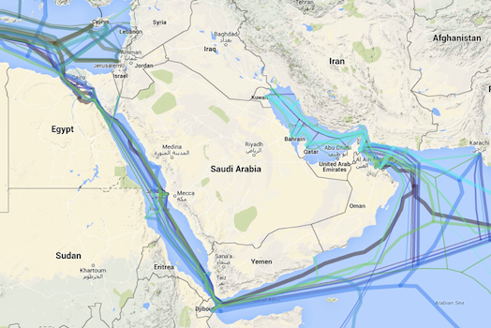
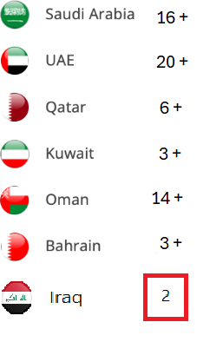
Number of Cable Landings at each GCC Country
Iraq 2
Kwt 3
Bah 4
Qtr 6
16+ Cable Sys
UAE 20+
Oman 14+
By Q3/Q4 2027 Iraq 6+

Slide 9
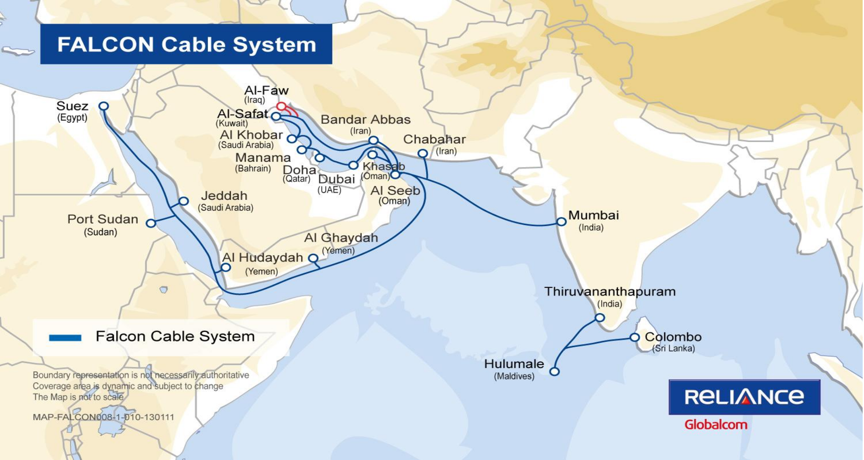
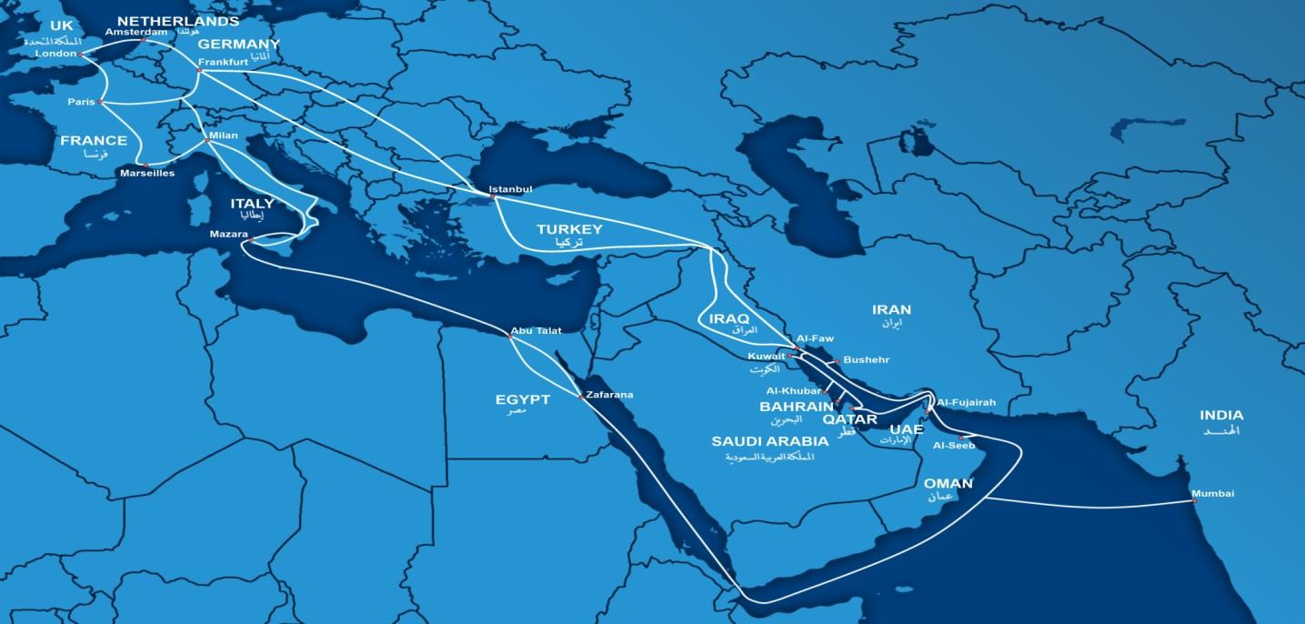
ITPC Infrastructures SUBMARINE CABLES
Falcon Cable System: One of the older cables providing connectivity in the region.
GBI marine Project
GBI (Gulf Bridge International): Links Iraq with the GCC countries and beyond.

Slide 10

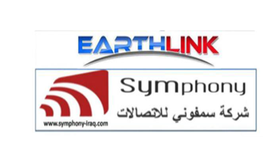

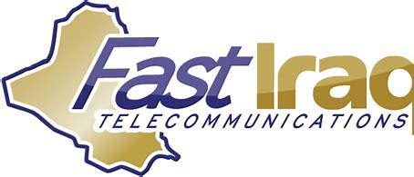

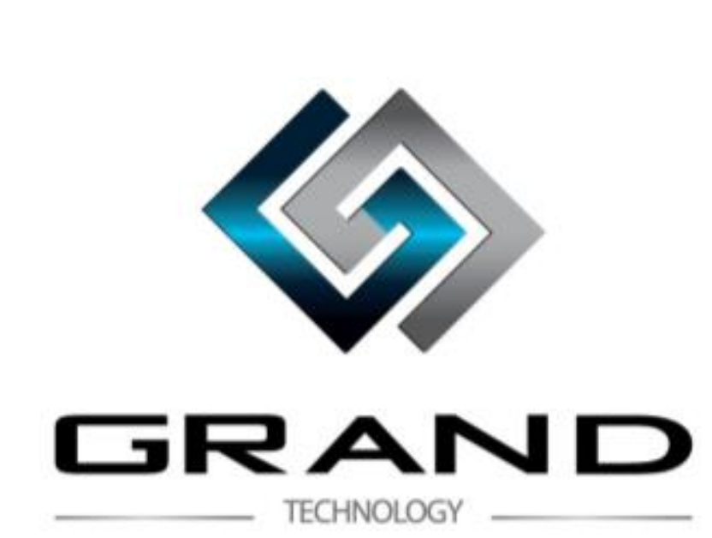

Transit Licensed companies
Transit Licensed companies
IQ networks Signed in: Sep 23, 2010
ITC Signed in: Jul 23, 2013
Symphony Signed in: Nov 10, 2015
Earth link Signed in: Sep 27, 2016
Muruj Alsafa Signed in: Nov 18, 2020
Fast Iraq Signed in: 2021
Grand technology/Dil Technology
Signed in: Apr 22, 2021
8. Two Consortium established and signed in 2010 and 2011 but all failed?

Slide 11
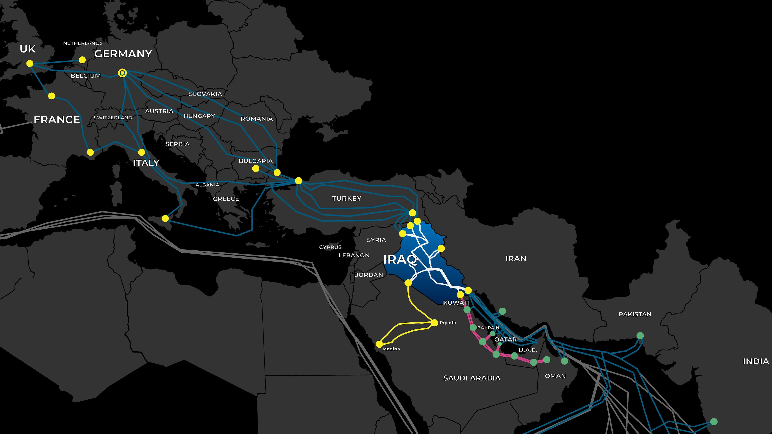
IQ Network Transit project
The Transit Network is a major fiber-optic infrastructure initiative led by iQ Networks, part of iQ Group, aimed at transforming Iraq into a digital transit hub between Europe and Asia.
Early 2025, iQ Networks signed Iraq’s first-ever dark fiber IRU (Indefeasible Right of Use) agreement with Gulf Bridge International (GBI) in Baghdad .
The project facilitates strong peering relationships with global OTT platforms (like Amazon, Google, Meta, TikTok), thereby reducing latency, improving user experience, and supporting AI, finance, and cloud-based services.

Slide 12
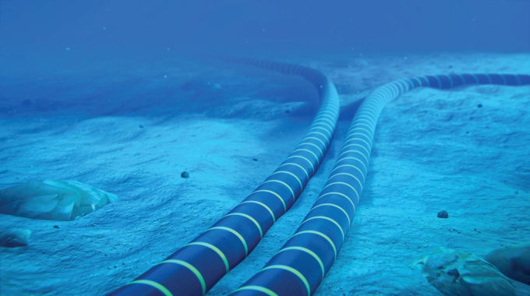
New projects
  Express Route: A new project aimed at enhancing Iraq’s digital connectivity and positioning it as a transit hub for data traffic.
  Ooredoo Group (FIG)- Submarine
  2Africa Cable - Submarine
  Breeze (World Link) - Submarine
  ZOI/OmanTel (Terriestal)
  Etisalat – submarine -Potential
  Kalaam Group (Zajal) - Terristal
  Batelco Khaleej –Submarine
  Others Consortium and terrestrial Routes (Babylon Gate EXA, FLAG)
Regional Digital and Transit Hub:
With the right investments and policies, Iraq can position itself as a regional digital hub, similar to UAE, Oman and Saudi Arabia.
Submarine cables significantly improve Iraq’s internet speed, reliability, and capacity, making it more competitive in the region.
Data Centres (Basra Data Hub), 2 x ITPC new data Centres.
One or More IXP

Slide 13

From Transit Hub to Digital Powerhouse
Strong Connections
More Fibre networks across Iraq
More international cables
Better access for all
Innovation & Skills
Train youth in digital skills
Support startups
Tech-focused research
Economic Growth
Help local businesses grow
Attract global investment
Expand e-commerce & e-services
Regional Partnership
Shared digital projects
Iraq as a trusted hub
Digital cultural & business exchange

Slide 14

  Iraq holds significant potential to emerge as a strategic transit and digital hub in the Middle East, leveraging its unique geographical position and improving infrastructure.
  Stakeholders, including government, private sector, and international partners, should collaborate to capitalize on Iraq's strategic location and invest in its infrastructure.
  By addressing challenges and implementing strategic initiatives, Iraq can enhance its role in regional connectivity, driving economic growth and development.

Slide 15
THANK YOU
Any Questions

